Slide 1

NOSQL Systems and MongoDB
History, Features, Data Model

Slide 2

How to manage huge amount of unstructured data?
Text, video, audio
Various no. of responses
Is relational DBMS a good solution?

Slide 3
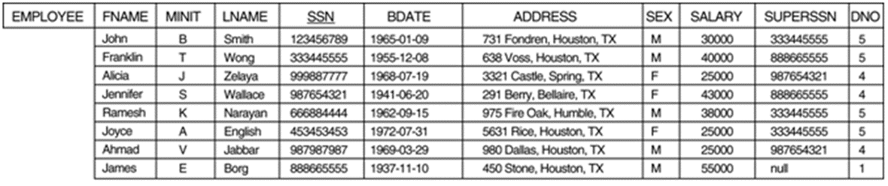
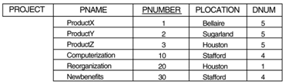
Relational DB
good for large amount of structured data
offer too many services (powerful query language, concurrency control, etc), which the application may not need.

Slide 4
Overview
In one day:
24 million transactions processed by Walmart
100 TB of data uploaded to Facebook
175 million tweets on Twitter
……….
How to store, query and process these data efficiently?
Notes:
30s

Slide 5
Overview
The problems with Relational Database:
Overhead for complex select, update, delete operations
Select: Joining too many tables to create a huge size table.
Update: Each update affects many other tables.
Delete: Must guarantee the consistency of data.
Not well-supported the mix of unstructured data.
Not well-scaling with very large size of data.
NoSQL is a good solution to deal with these problems.
Notes:
https://infocus.emc.com/april_reeve/big-data-and-nosql-the-problem-with-relational-databases/
1min

Slide 6
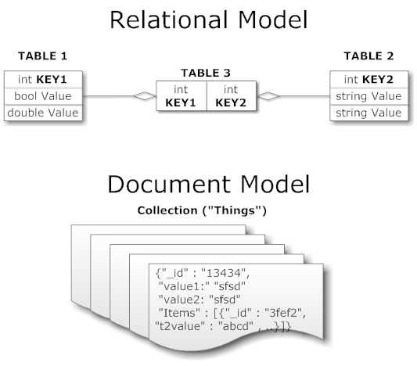
Overview
What is NoSQL:
NoSQL = Not only SQL
Wikipedia’s definition:
A NoSQL database provides a mechanism for storage and retrieval of data that is modeled in means other than the tabular relations used in relational databases.

Slide 7
NOSQL Systems
Most NOSQL systems are distributed databases
with a focus on
semi-structured data storage
high performance
availability
data replication
scalability
as opposed to an emphasis on
immediate data consistency
powerful query languages
structured data storage
Notes:
https://infocus.emc.com/april_reeve/big-data-and-nosql-the-problem-with-relational-databases/
1min

Slide 8
Characteristics of NOSQL Systems
Related to distributed database systems
Scalability: horizontal and vertical
Availability, replication and eventual consistency
Replication models
Sharding of files
High-performance data access
Related to data models and query languages
Not requiring a schema
Less powerful query language
Versioning
Notes:
https://infocus.emc.com/april_reeve/big-data-and-nosql-the-problem-with-relational-databases/
1min

Slide 9
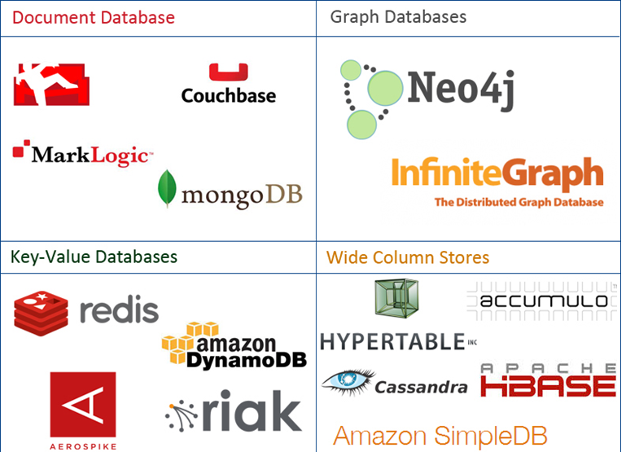
Overview – NoSQL Family
Notes:
https://www.mongodb.com/nosql-explained http://aryannava.com/2014/04/06/nosql-databases-family/

Slide 10
Major Categories of NOSQL Systems
Document-based
Store data in the form of documents, such as JSON
Key-value stores
(key value), the value can be a record, an object, a document, or even have a more complex data structure
Column-based or wide column
Partition a table by column into column families (vertical partitioning)
Graph-based
Data is represented as graphs

Slide 11
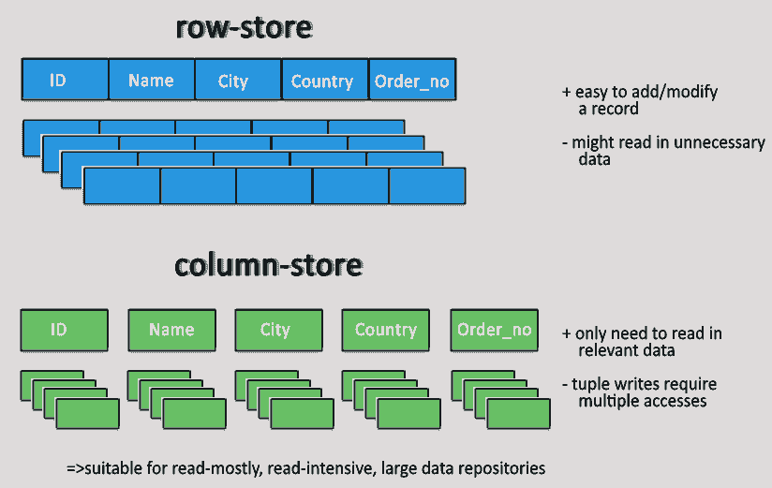
Row-Store and Column-Store

Slide 12
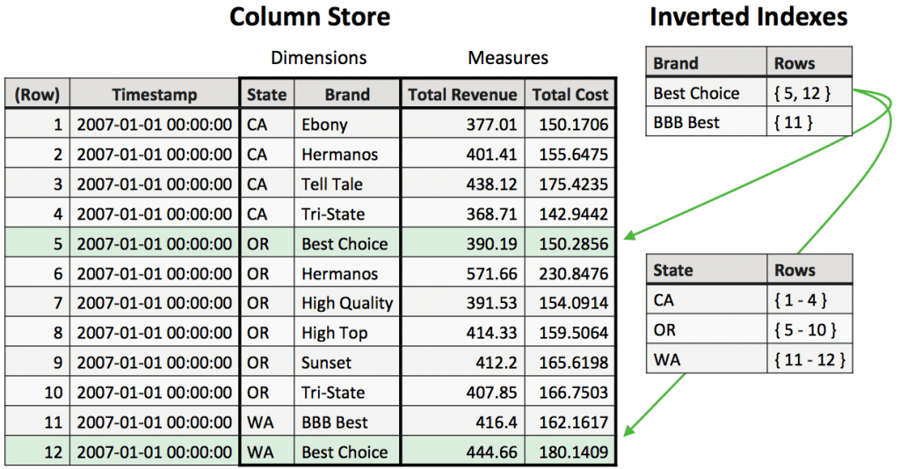
Column Families and Inverted Indexes

Slide 13
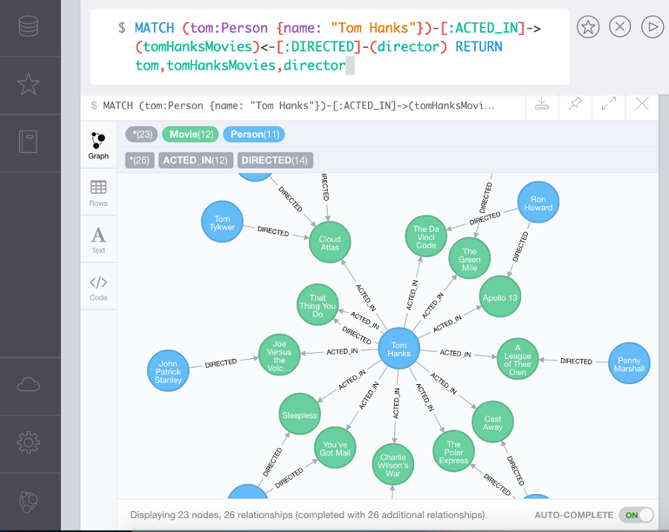
Graph-based DBMS: Neo4J

Slide 14
What is MongoDB?
First developed by 10gen (later MongoDB, Inc.) in 2007
Name comes from “humongous”
Became open source in 2009
It is a NoSQL database
A document-oriented database
Designed with both scalability and developer agility

Slide 15
Example of a mongoDB Document
{
_id: 1234,
author: { name: “Bob Jones”, email: “b@b.com” },
post: “In these troubled times I like to ...“,
date: { $date: “2014-03-12 13:23UTC” },
location: [ -121.2322, 48.1223222 ],
rating: 2.2,
comments: [
{ user: “lalal@hotmail.com”,
upVotes: 22,
downVotes: 14,
text: “Great point! I agree” },
{ user: “pedro@gmail.com”,
upVotes: 421,
downVotes: 22,
text: “You are a...” }
],
tags: [ “databases”, “mongo” ]
}

Slide 16
Motivations
Problems with SQL
Rigid schema
Not easily scalable (designed for 90’s technology or worse)
Requires unintuitive joins
Perks of mongoDB
Easy interface with common languages (Java, Javascript, PHP, etc.)
DB tech should run anywhere (VM’s, cloud, etc.)
Keeps essential features of RDBMS’s while learning from key-value noSQL systems
http://www.slideshare.net/spf13/mongodb-9794741?v=qf1&b=&from_search=13
Notes:
Quotes from a person

Slide 17

Company Using mongoDB
“MongoDB powers Under Armour’s online store, and was chosen for its dynamic schema, ability to scale horizontally and perform multi-data center replication.”
http://www.mongodb.org/about/production-deployments/

Slide 18
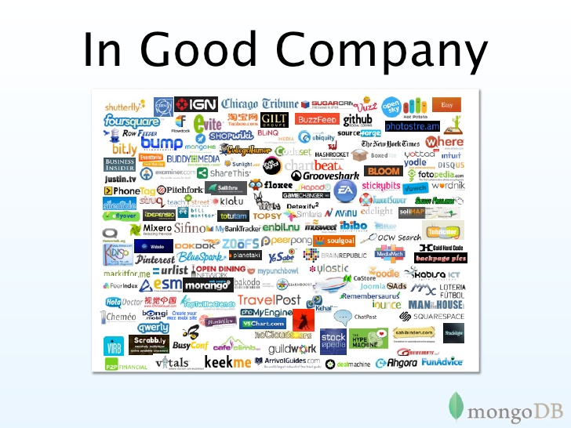

Slide 19
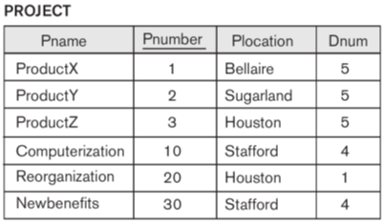
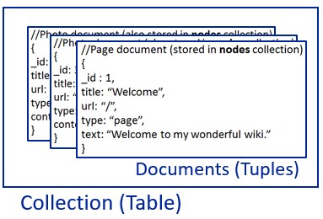
SQL vs MongoDB
SQL Terms/Concepts | MongoDB Terms/Concepts
database | database
table | collection
row | document
column | field
index | index
table joins (e.g. select queries) | embedded documents and linking
foreign Key | reference
primary keys | _id field is always the primary key
aggregation (e.g. group by) | aggregation pipeline
relational schema | schema-less
Notes:
What is the index in MongoDB
Embedded documents and linking??
Aggregation pipeline??
http://docs.mongodb.org/manual/core/data-model-design/

Slide 20
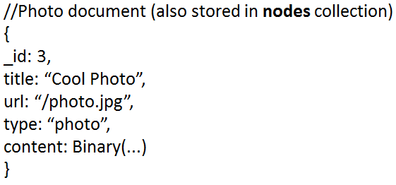
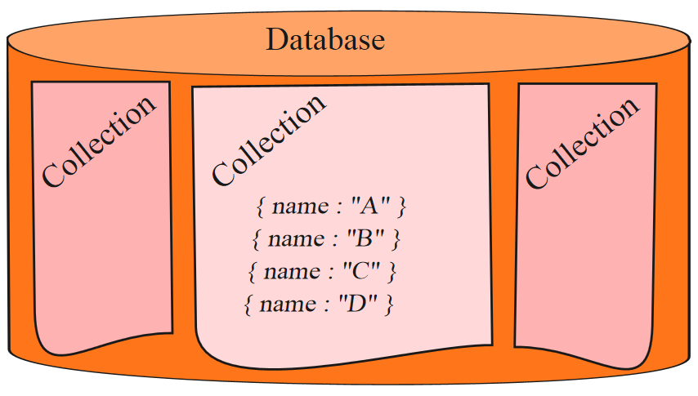
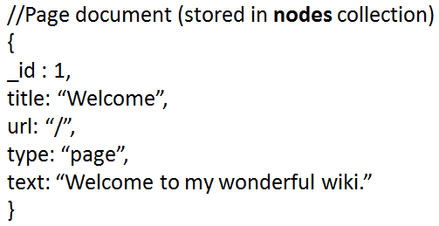
Mongo is basically schema-free
Why can’t we have the database operating on the same data structure as in program?
That is where mongoDB comes in
Every “document” in a database “collection” is a data structure, much like a “struct” in C, or a “class” in Java.
A collection is then an array (or list) of such data structures
C/Java/
JavaScript
Program
Documents (Tuples)
Collection (Table)

Slide 21
Basic Ideas
{
_id: 1234,
author: { name: “Bob Jones”, email: “b@b.com” },
post: “In these troubled times I like to ...“,
date: { $date: “2014-03-12 13:23UTC” },
location: [ -121.2322, 48.1223222 ],
rating: 2.2,
comments: [
{ user: “lalal@hotmail.com”,
upVotes: 22,
downVotes: 14,
text: “Great point! I agree” },
{ user: “pedro@gmail.com”,
upVotes: 421,
downVotes: 22,
text: “You are a...” }
],
tags: [ “databases”, “mongo” ]
}
Collections of JSON objects
Data stored as BSON (Binary JSON)
Embed objects within a single document
References/Linking
No schema
No join
Max document size of 16MB, larger documents handled with GridFS.
Runs on most common OS
Windows, Linux, Mac, Solaris.

Slide 22
Another Example
{
"business_id": "rncjoVoEFUJGCUoC1JgnUA",
"full_address": "8466 W Peoria Ave\nSte 6\nPeoria, AZ 85345",
"open": true,
"categories": ["Accountants", "Professional Services", "Tax Services",],
"city": "Peoria",
"review_count": 3,
"name": "Peoria Income Tax Service",
"neighborhoods": [],
"longitude": -112.241596,
"state": "AZ",
"stars": 5.0,
"latitude": 33.581867000000003,
"type": "business"
}

Slide 23
Installation
Download and install suitable package for each platform [Windows, Linux, Mac OSX, Solaris]
Create a folder e.g. C:\mongodb
Go to bin of installation folder.
Type following command: mongod -- dbpath=C:/mongodb
Run another command: mongo.exe
The mongodb server is running.

Slide 24

MongoDB
Data Model,
Create, Retrieve, Update, Delete (CRUD)

Slide 25
JSON
Easy for humans to write/read, easy for computers to parse/generate
Objects can be nested
Built on
Field-value pairs
Ordered list of values
{
"_id" : "37010"
"city" : "ADAMS",
"pop" : 2660,
"state" : "TN",
“councilmen” : [“John Smith”, “Jim Curry”, “Mary Lee”]
}

Slide 26
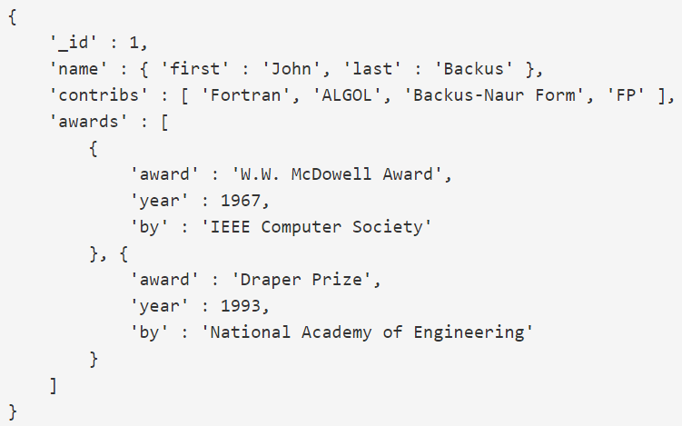
Another JSON Example

Slide 27
JSON and BSON
JSON (JavaScript Object Notation)
A JSON database returns query results that can be easily parsed, with little or no transformation, directly by JavaScript and most popular programming languages – reducing the amount of logic you need to build into your application layer.
BSON (Binary JSON)
MongoDB represents JSON documents in binary-encoded format called BSON behind the scenes.
BSON extends the JSON model to provide additional data types and to be efficient for encoding and decoding within different languages.

Slide 28
MongoDB Data Model₋₁
A mongo database is a set of collections.
Collections
Like tables of relational db’s.
A collection include documents, having index set in common
A document is like a row of a relational table.
Documents (Tuples)
Collection (Table)

Slide 29
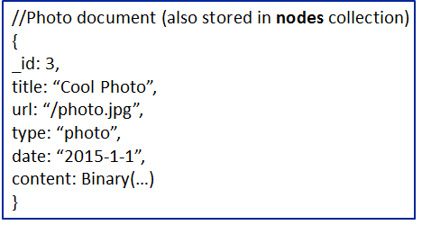
MongoDB Data Model₋₂
Documents in a collection
must have an _id.
BSON format, consisting of field-value pairs
max 16 MB per document
do not have to have uniform structure
Enables simpler schema migration.
Better mapping of object-oriented inheritance and polymorphism.

Slide 30
The _id Field
By default, each document contains an _id field. This field has a number of special characteristics:
Value serves as primary key for collection.
Value is unique, immutable, and may be any non-array type.
Default data type is ObjectId, which is “small, likely unique, fast to generate, and ordered.”
Sorting on an ObjectId value is roughly equivalent to sorting on creation time.

Slide 31
The Value of Field
Native data types
Arrays
Other documents
Structure of a JSON-document:
Notes:
The schema is very flexible. Documents in each collection can have different structures.

Slide 32
BSON Types
Type | Number
Double | 1
String | 2
Object | 3
Array | 4
Binary data | 5
Object id | 7
Boolean | 8
Date | 9
Null | 10
Regular Expression | 11
JavaScript | 13
Symbol | 14
JavaScript (with scope) | 15
32-bit integer | 16
Timestamp | 17
64-bit integer | 18
Min key | 255
Max key | 127
The number can be used with the $type operator to query by type!
http://docs.mongodb.org/manual/reference/bson-types/

Slide 33
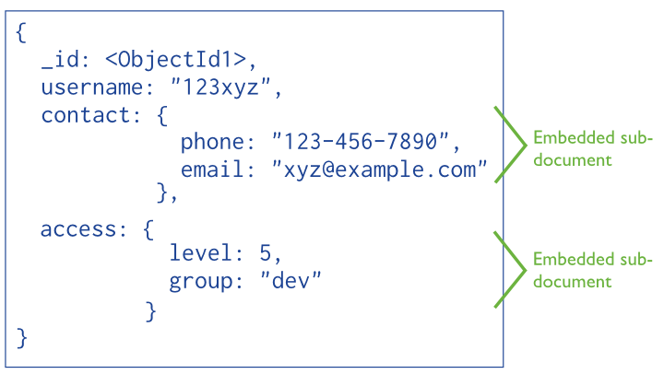
Embedded Sub-Document
Embedded documents:
The primary key
Notes:
With embedded documents, we do not need complicated join table.
Why objectId1 – a hex string

Slide 34
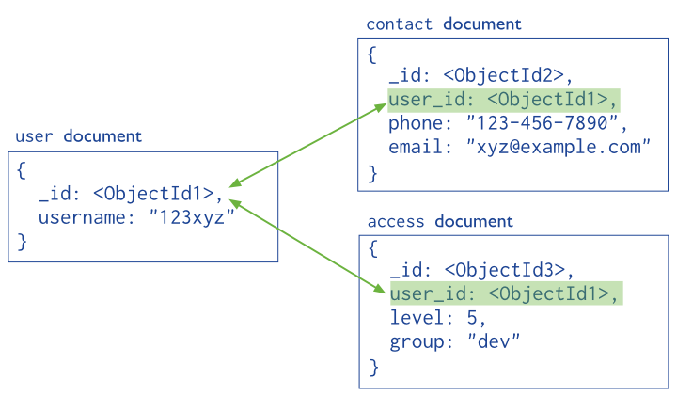
Reference/Linking Documents
Reference documents or linking documents
Notes:
With embedded documents, we do not need complicated join table.
Why objectId1 – a hex string

Slide 35
A (Denormalized) Embedded Structure An Array of Values
{
"business_id": "rncjoVoEFUJGCUoC1JgnUA",
"full_address": "8466 W Peoria Ave\nSte 6\nPeoria, AZ 85345",
"open": true,
"categories": ["Accountants", "Professional Services", "Tax Services"],
"city": "Peoria",
"review_count": 3,
"name": "Peoria Income Tax Service",
"neighborhoods": [],
"longitude": -112.241596,
"state": "AZ",
"stars": 5.0,
"latitude": 33.581867000000003,
"type": "business“
}

Slide 36
A (Denormalized) Embedded Structure An Array of Sub Documents
{
“_id” : “First Post”,
“comments” : [
{“author” : “Bob”, “text” : “Nice Post!”},
{“author” : “Tom”, “text” : “Dislike!”}
],
“comment_count” : 2
}

Slide 37
A Normalized Structure (Reference/Linking)
//db.post schema
{
“_id” : “First Post”,
“author” : “Rick”,
“text” : “This is my first post.”
}
//db.comments schema
{
“_id” : ObjectID(...),
“post_id” : “First Post”,
“author” : “Bob”,
“text” : “Nice Post!”
}
reference

Slide 38
MongoDB
Query, Index, Sharding, Replication

Slide 39
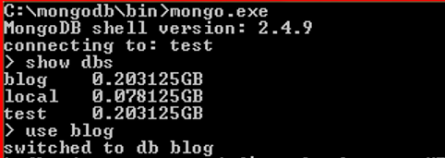
CRUD: Using the Shell
To check which db you’re using db
Show all databases show dbs
Switch db’s/make a new one use <db_name>
See what collections exist show collections

Slide 40
MongoDB Create and Query
Create a collection:
db.createCollection(<name>, <options>)
options: specify the number of documents in a collection etc.
db.createCollection(“students”, {max : 5000})
Insert a document:
db.<collection>.insert(<document>)
db.students.insert({“name”: “nguyen”, “age”: 24, “gender”: “male”})
<=>
INSERT INTO students(name, age, gender)
VALUES (‘nguyen’, 24, ‘male’);

Slide 41
SQL Statement | MongoDB commands
SELECT * FROM table | db.collection.find()
SELECT * FROM table WHERE artist = ‘Nirvana’ | db.collection.find({Artist:”Nirvana”})
SELECT* FROM table ORDER BY Title | db.collection.find().sort(Title:1)
DISTINCT | .distinct()
GROUP BY | .group()
>=, < | $gte, $lt
Retrieving Data

Slide 42
CRUD: Querying
Get all docs: db.<collection>.find()
Returns a cursor, which is iterated over shell to display up to first 20 results.
Add .limit(<number>) to limit results
SELECT * FROM <table>;
Get one doc: db.<collection>.findOne()
Query with conditions:
db.<collection>.find({<field>:<value>})
db.students.find({ “gender”: “female”}).limit(5)

Slide 43
CRUD: Querying
“AND”
db.<collection>.find({<field1>:<value1>, <field2>:<value2>})
db.students.find( { “gender”: “female”, “age”: {$lte:20}})
SELECT *
FROM students
WHERE gender = “female” AND age <= 20;

Slide 44
CRUD: Querying
“OR”
db.<collection>.find({ $or: [<field>:<value1>, <field>:<value2>]})
db.students.find({ $or: [“age”: {$lte:20}, “age”: {$gte:40}]})
SELECT *
FROM students WHERE age <= 20 OR age >= 40;
Checking for multiple values of same field
db.<collection>.find({<field>: {$in [<value>, <value>]}})

Slide 45
CRUD: Querying
Including/excluding document fields
db.<collection>.find({<field1>:<value>}, {<field2>: 0})
SELECT field1
FROM <table>;
db.<collection>.find({<field>:<value>}, {<field2>: 1})
Find documents with or w/o field
db.<collection>.find({<field>: { $exists: true}})
Excluding <field2>
Including <field2>

Slide 46
Query Example
db.posts.find({ author.name: “mike” })
db.posts.find({ rating: { $gt: 2 }})
db.posts.find({ tags: “software” }).pretty()
db.posts.find().sort({date: -1}).limit(10)
// select * from posts where ‘economy’ in tags order by ts DESC
db.posts.find({tags :‘economy’}).sort({ts :-1 }).limit(10);
Note: pretty() displays the results in a formatted way.
http://try.mongodb.org/

Slide 47
CRUD: Updating
db.<collection>.update(
{<field1>:<value1>}, //all docs in which field = value
{$set: {<field2>:<value2>}}, //set field to value
{multi:true} ) //update multiple docs
db.students.update({'name':'nguyen'}, { $set:{'age': 20 } } )
upsert: if true, creates a new doc when none matches search criteria.
UPDATE students
SET age = 20
WHERE name = “nguyen”;

Slide 48
CRUD: Updating
To replace the existing document with new one:
save method
db.students.save({_id:ObjectId(‘string_id’), “name”: “ben”, “age”: 23, “gender”: “male”}
To remove a field
db.<collection>.update({<field>:<value>}, { $unset: { <field>: 1}})
To remove the field quantity from the first document in the products collection where the field sku has a value of unknown.
db.products.update({sku: “unknown”}, {$unset: {quantity: 1}})

Slide 49
CRUD: Delete
Drop a database
Show database: show dbs
Use a database: use <db_name>
Drop it: db.dropDatabase()
Drop a collection:
db.<collection>.drop()
Delete all documents where field = value
db.<collection>.remove({<field>:<value>})
DELETE FROM <table>
WHERE <field> = <value>;
As above, but only delete first document
db.<collection>.remove({<field>:<value>}, true)

Slide 50
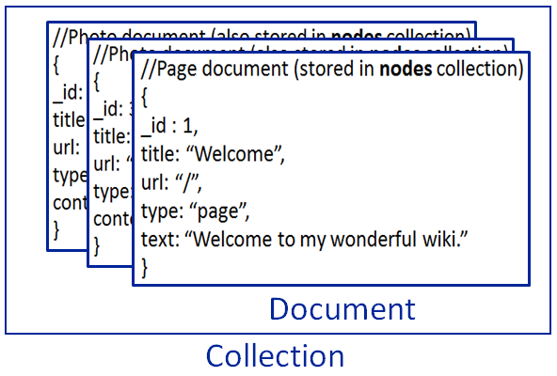
CRUD: Isolation
By default, all writes are atomic only on the level of a single document.
This means that, by default, all writes can be interleaved with other operations.
You can isolate writes on an unsharded collection by adding $isolated:1 in the query area:
db.<collection>.remove({<field>:<value>, $isolated: 1})
No operations will interleave with this removal of the matched documents before completion.

Slide 51
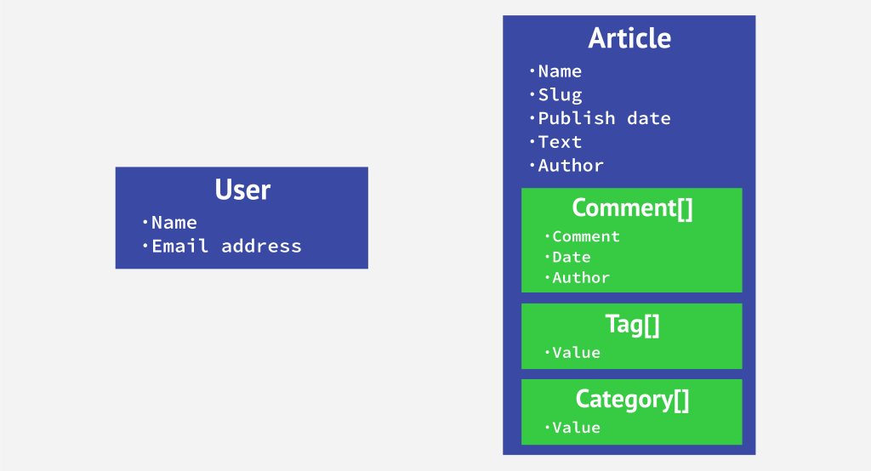
Relationship between Documents
Two ways to establish the connection: embedding and linking

Slide 52
One to One relationship
zip = {
_id: 35004 ,
city: “ACMAR”
loc: [-86, 33],
pop: 6065,
State: “AL”,
council_person: {
name: “John Doe",
address: “123 Fake St.”,
Phone: 123456
}
}
zip = {
_id: 35004,
city: “ACMAR”,
loc: [-86, 33],
pop: 6065,
State: “AL”
}
Council_person = {
zip_id = 35004,
name: “John Doe",
address: “123 Fake St.”,
Phone: 123456
}
linking
embedding

Slide 53


One to many relationship - Embedding
book = {
title: "MongoDB: The Definitive Guide",
authors: [ "Kristina Chodorow", "Mike Dirolf" ]
published_date: ISODate("2010-09-24"),
pages: 216,
language: "English",
publisher: {
name: "O’Reilly Media",
founded: "1980",
location: "CA"
}
}
publish

Slide 54
One to many relationship – Linking
publisher = {
_id: "oreilly",
name: "O’Reilly Media",
founded: "1980",
location: "CA"
}
book = {
title: "MongoDB: The Definitive Guide",
authors: [ "Kristina Chodorow", "Mike Dirolf" ]
published_date: ISODate("2010-09-24"),
pages: 216,
language: "English",
publisher_id: "oreilly"
}
publish

Slide 55
Many to many relationship
Can put relation in either one of the documents (embedding in one of the documents)
Focus how data is queried
book = {
title: "MongoDB: The Definitive Guide",
authors : [
{ _id: "kchodorow", name: "Kristina Chodorow” },
{ _id: "mdirolf", name: "Mike Dirolf” }
]
published_date: ISODate("2010-09-24"),
pages: 216,
language: "English"
}
author = {
_id: "kchodorow",
name: "Kristina Chodorow",
hometown: "New York"
}
db.book.find( { authors.name : "Kristina Chodorow" } )

Slide 56
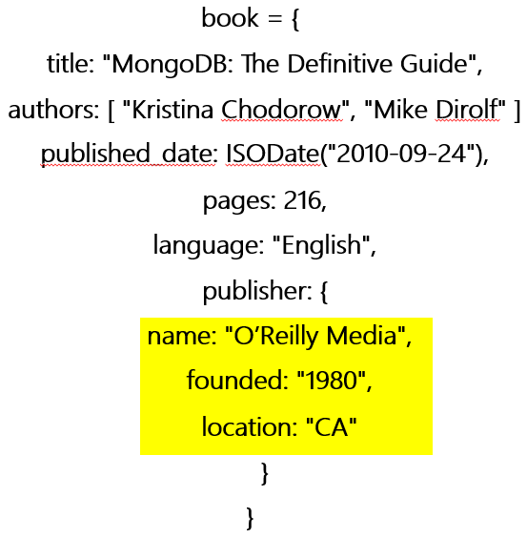
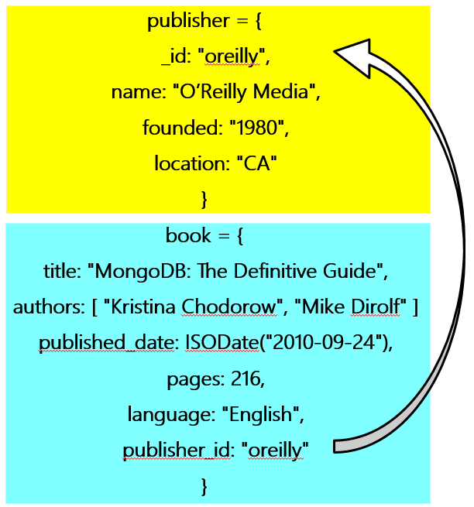
Linking vs. Embedding
To embed or not to embed. That is the question!
Rule of thumb is to embed whenever possible.
Embed when the “many” objects always appear with (viewed in the context of) their parents.
Embedding (de-normalization) is a bit like pre-joining data which provides data locality and improves speed.
Linking when you need more flexibility
Linking
Embedding

Slide 57
Example-Book Checkout
Book can be checked out by one student at a time
Student can check out many books
student = {
_id: "joe"
name: "Joe Bookreader",
join_date: ISODate("2011-10-15"),
address: { ... }
}
book = {
_id: "123456789"
title: "MongoDB: The Definitive Guide",
authors: [ "Kristina Chodorow", "Mike Dirolf" ],
...
}

Slide 58
Modeling Checkouts
student = {
_id: "joe"
name: "Joe Bookreader",
join_date: ISODate("2011-10-15"),
address: { ... },
checked_out: [
{ book_id: "123456789", checked_out: "2012-10-15" },
{ book_id: "987654321", checked_out: "2012-09-12" },
...
]
}
Joe checks out many books.

Slide 59
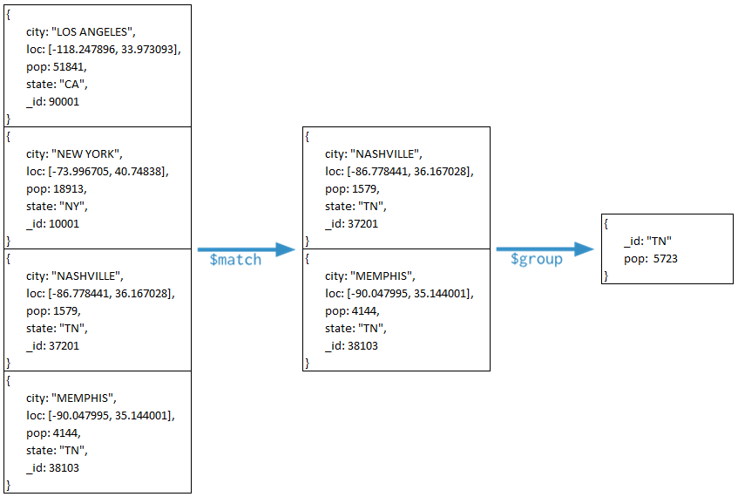
MongoDB
Aggregation

Slide 60
Aggregation
Operations that process data records and return computed results.
MongoDB provides aggregation operations.
Aggregation piplelines
MapReduce
Single purpose aggregation operations
Running data aggregation on the mongod instance simplifies application code and limits resource requirements.

Slide 61
Aggregation Pipelines
Modeled on the concept of data processing pipelines.
Provides:
filters that operate like queries
document transformations that modify the form of the output document.
Provides tools for:
grouping and sorting by field
aggregating the contents of arrays, including arrays of documents
Can use operators for tasks such as calculating the average or concatenating a string.

Slide 62
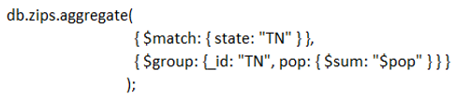
Aggregation Pipelines
zips
Sum populations of “TN”

Slide 63
Pipelines
$limit
Passes the first n documents unmodified to the pipeline where n is the specified limit.
$skip
Skips the first n documents where n is the specified skip number and passes the remaining documents unmodified to the pipeline.
$sort
Reorders the document stream by a specified sort key. Only the order changes; the documents remain unmodified.
db.users.aggregate(
[
{ $sort : { age : -1, posts: 1 } }
]
)
db.article.aggregate(
{ $limit : 5 }
);
db.article.aggregate(
{ $skip : 5 }
);
descending

Slide 64
db.article.aggregate({“$project” : {“author” : 1}},
{“$group” : {“_id” : “$author”, “count” : {“$sum” : 1}}},
{“$sort” : {“count” : -1}},
{ $limit : 5 })
{
“result” : [
{
“_id” : “R. L. Stine”,
“count” : 430
},
{
“_id” : “Edgar Wallace”,
“count” : 175
},
{
“_id” : “Nora Roberts”,
“count” : 170
},
{
“_id” : “Agatha Christie”,
“count” : 140
},
{
“_id” : “Stanle Gardner”,
“count” : 80
},
],
“ok” : 1
}
equivalent to operator count

Slide 65
Map-Reduce
Has two phases:
A map stage that processes each document and emits one or more objects for each input document.
A reduce phase that combines the output of the map operation.
An optional finalize stage for final modifications to the result.
Uses Custom JavaScript functions
Provides greater flexibility but is less efficient and more complex than the aggregation pipeline
Can have output sets that exceed the 16 megabyte output limitation of the aggregation pipeline.

Slide 66
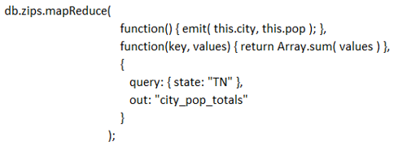
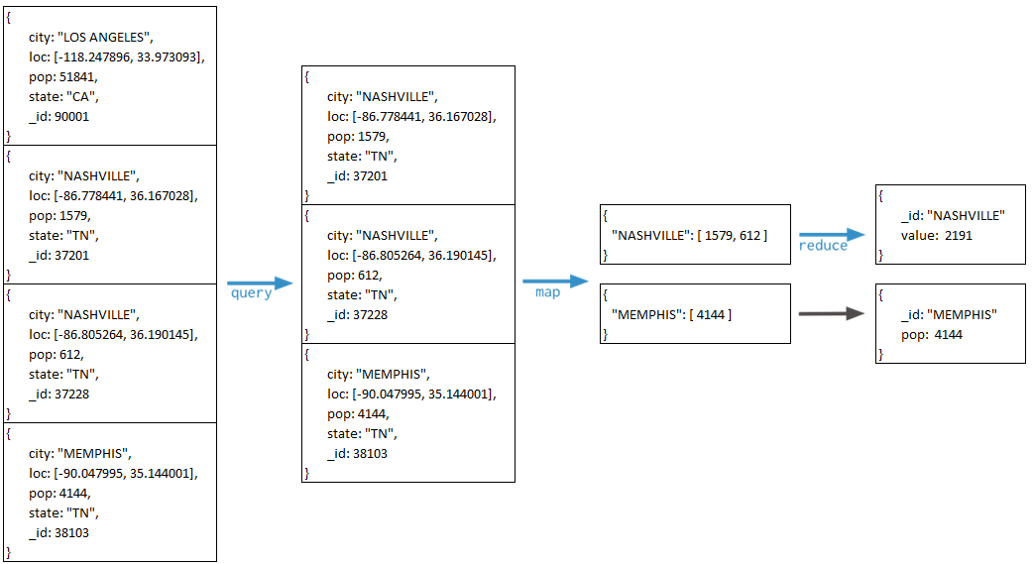

Slide 67
Single Purpose Aggregation Operations
Special purpose database commands:
count: returning a count of matching documents
db.people.count()
distinct: returning the distinct values for a field
db.people.distinct(“age”)
Return distinct values of “age” in collection “people”.
group: grouping data based on the values of a field.
Aggregate documents from a single collection.
Lack the flexibility and capabilities of the aggregation pipeline and map-reduce.

Slide 68
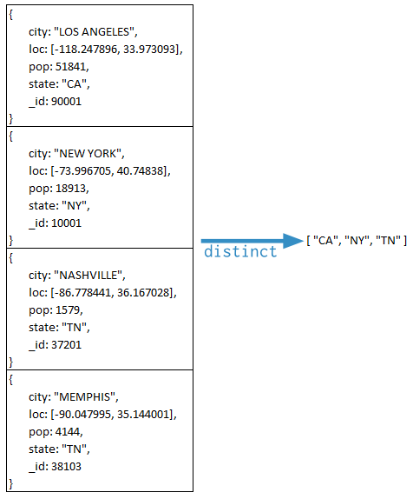
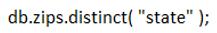
In collection “zips”,
find distinct values in “state” field.

Slide 69
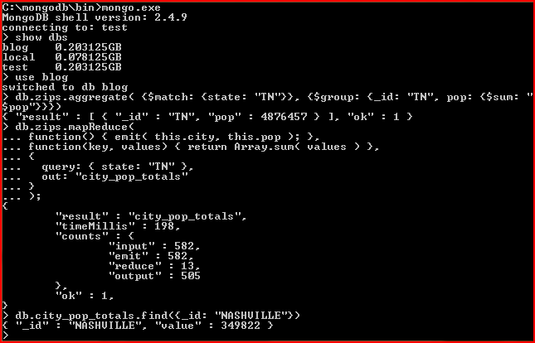
Aggregation Pipelines and Map-Reduce

Slide 70
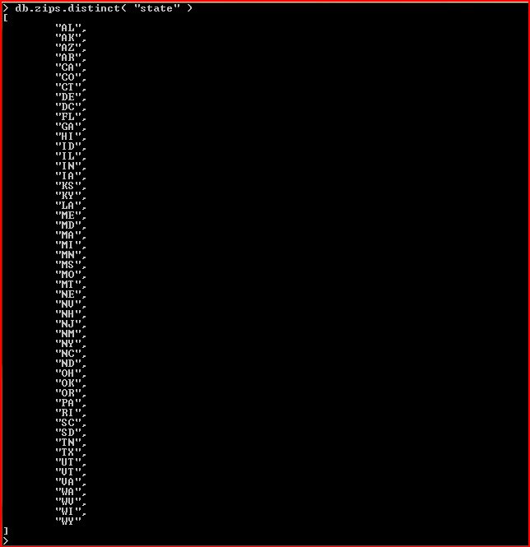
Single Purpose Aggregation Operation

Slide 71
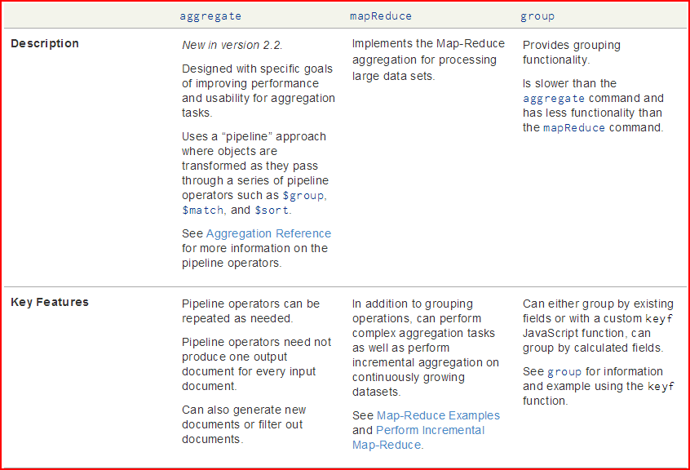

Slide 72
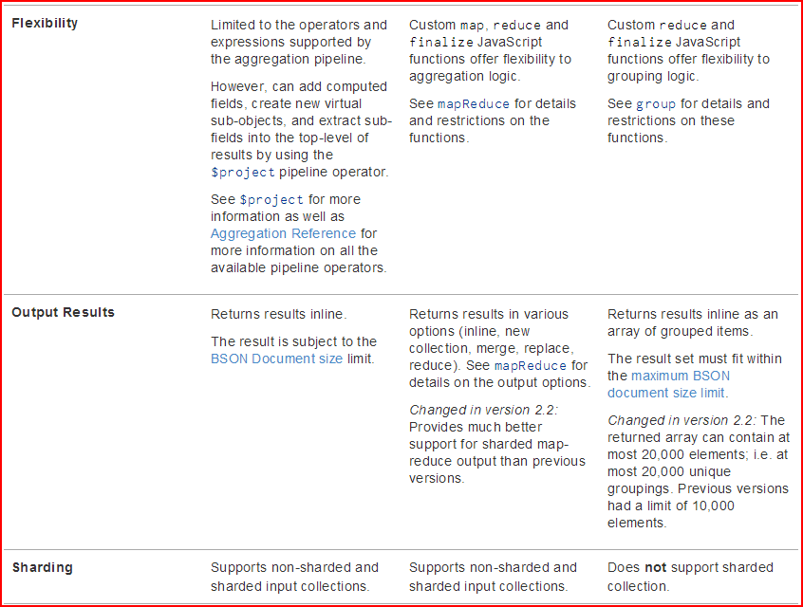

Slide 73
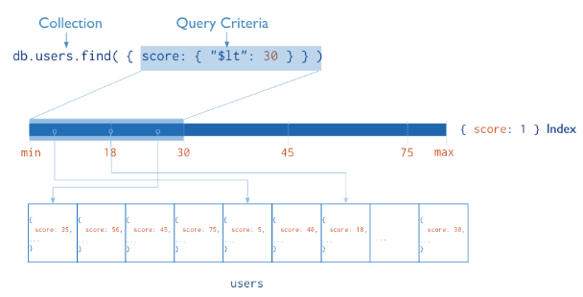
MongoDB Index
db.users.find( { score: { “$lt” : 30} } )

Slide 74
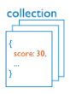
Before Index
What does database normally do when we query?
MongoDB must scan every document.
Inefficient because process large volume of data
db.users.find( { score: { “$lt” : 30} } )
scan every document and find results

Slide 75
Definition of Index
Definition
Indexes are special data structures that store a small portion of the collection’s data set in an easy to traverse form.
scan index and find results
Diagram of a query that uses an index to select

Slide 76
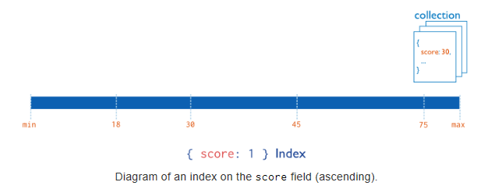
Create Index in MongoDB
Types
Single Field Indexes
Compound Field Indexes
Multikey Indexes
Single Field Indexes
db.users.ensureIndex( { score: 1 } )

Slide 77
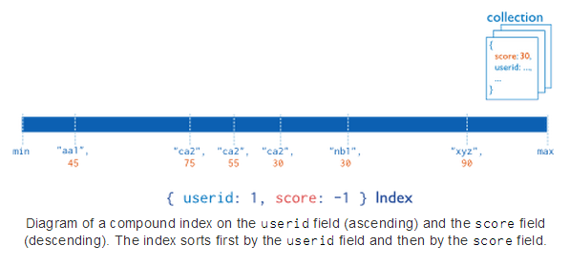
Compound Field Index
Types
Single Field Indexes
Compound Field Indexes
Multikey Indexes
Compound Field Indexes
db.users.ensureIndex({ userid:1, score: -1 } )

Slide 78
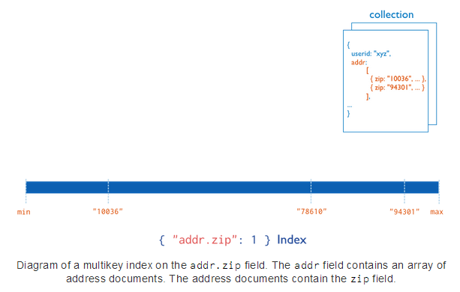
Multikey Indexes
Types
Single Field Indexes
Compound Field Indexes
Multikey Indexes
Multikey Indexes
db.users.ensureIndex({addr.zip:1} )
In single field index, there is only one index key in each document
MongoDB creates an index key for each element in the array ‘addr’.
Two index keys, 10036 and 94301, in this document

Slide 79
Index in MongoDB
Creation index
db.users.ensureIndex( { score: 1 } )
Show existing indexes
db.users.getIndexes()
Drop index
db.users.dropIndex( {score: 1} )
Explain—Explain
db.users.find().explain()
Returns a document that describes the process and indexes
Hint
db.users.find().hint({score: 1})
Overide MongoDB’s default index selection

Slide 80
Demo of indexes in MongoDB
Import Data
Create Index
Single Field Index
Compound Field Indexes
Multikey Indexes
Show Existing Index
Hint
Single Field Index
Compound Field Indexes
Multikey Indexes
Explain
Compare with data without indexes

Slide 81
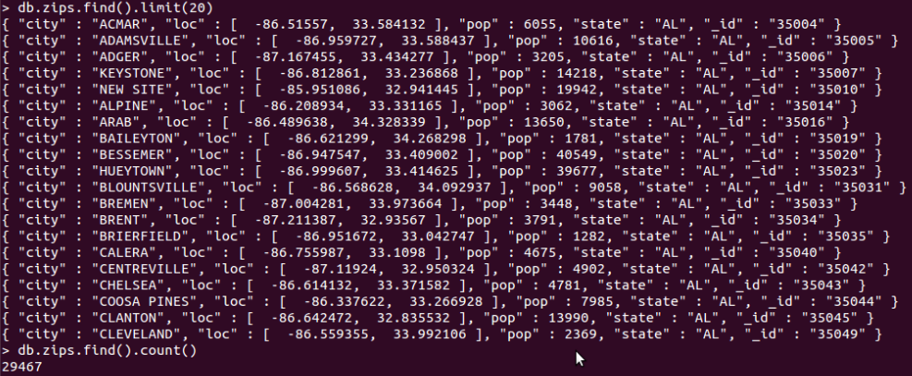
Import Data: zips Collection

Slide 82
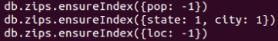
Create Index
Single Field Index
Compound Field Indexes
Multikey Indexes

Slide 83
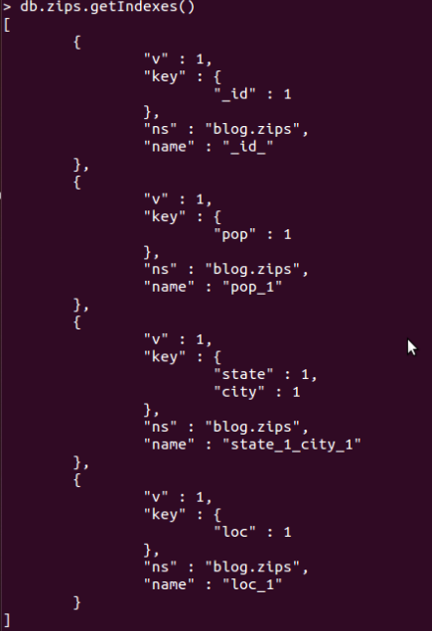
Show Existing Index
DB: blog
Collection: zips
One identifier index
Three user defined indices.

Slide 84
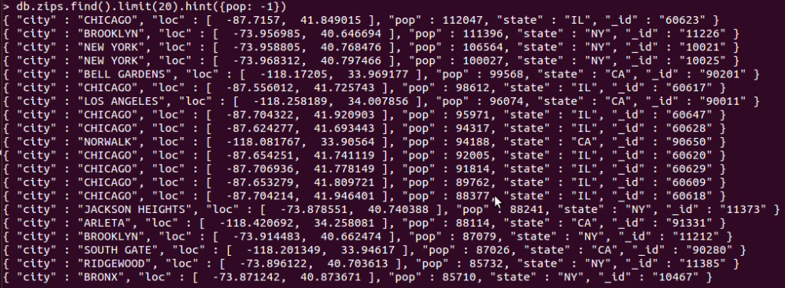
Hint
Hint: force MongoDB to use the specified index
Single Field Index
Compound Field Indexes
Multikey Indexes
Pop in decreasing order

Slide 85
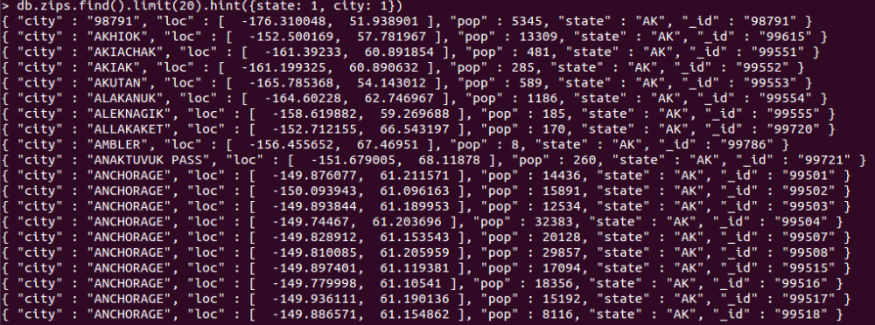
Hint
Hint
Single Field Index
Compound Field Indexes
Multikey Indexes
State and city in increasing order

Slide 86
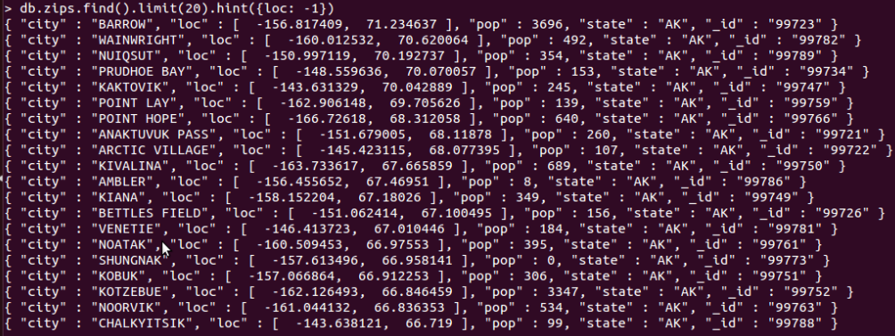
Hint
Hint
Single Field Index
Compound Field Indexes
Multikey Indexes
loc in decreasing order

Slide 87
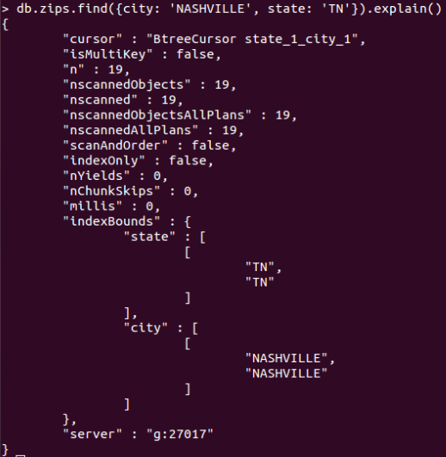
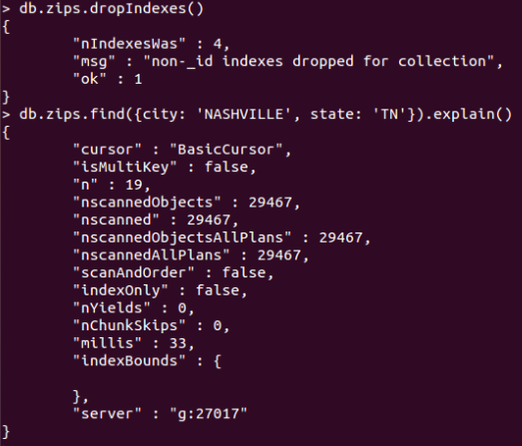
Explain
to provide information on the query plan
with index
without index

Slide 88
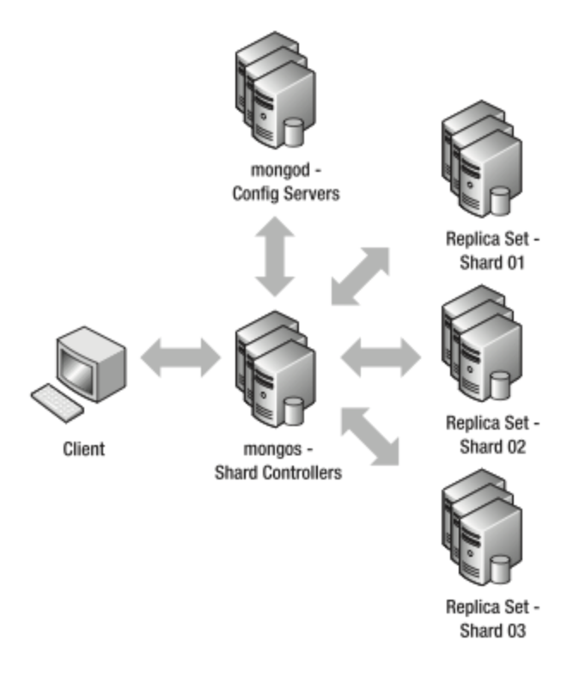
Replication & Sharding
A123…
B123…
C123…
A123…
B123…
C123…
A123…
B123…
C123…
D123…
E123…
F123…
D123…
E123…
F123…
D123…
E123…
F123…
G123…
H123…
I123…
G123…
H123…
I123…
G123…
H123…
I123…
Image source: http://mongodb.in.th

Slide 89
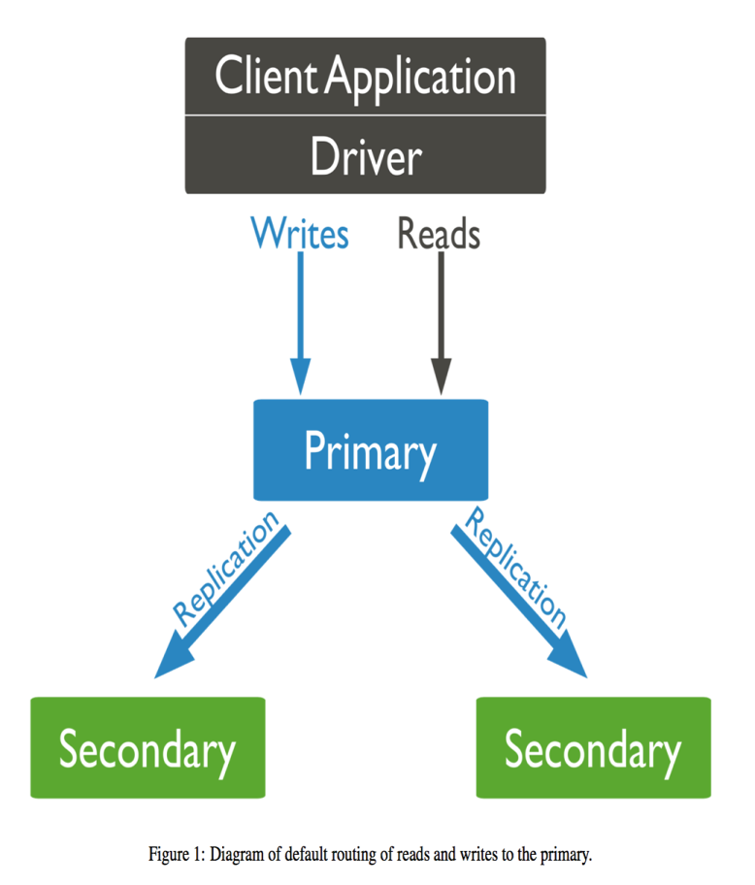
Replication
What is replication?
Purpose of replication/redundancy
Fault tolerance
Availability
Increase read capacity

Slide 90
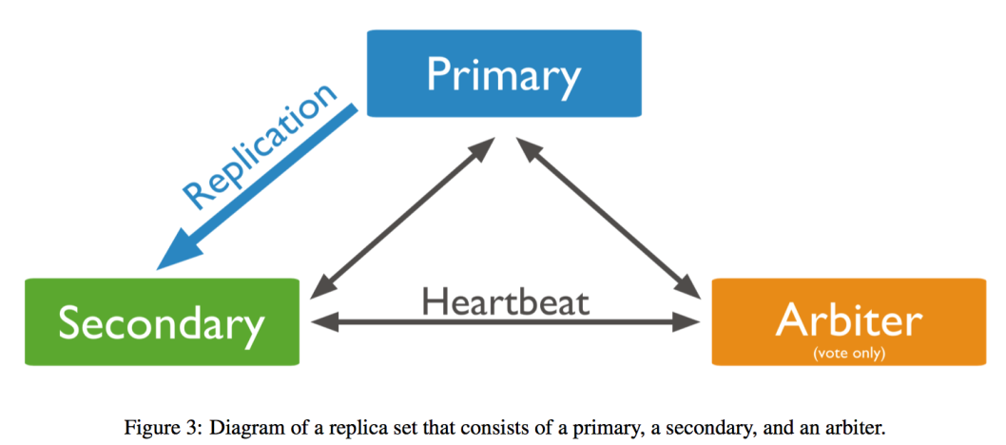
Replication in MongoDB
Replica Set Members
Primary
Read, Write operations
Secondary
Asynchronous Replication
Can be primary
Arbiter
Voting
Can’t be primary
Delayed Secondary
Can’t be primary

Slide 91
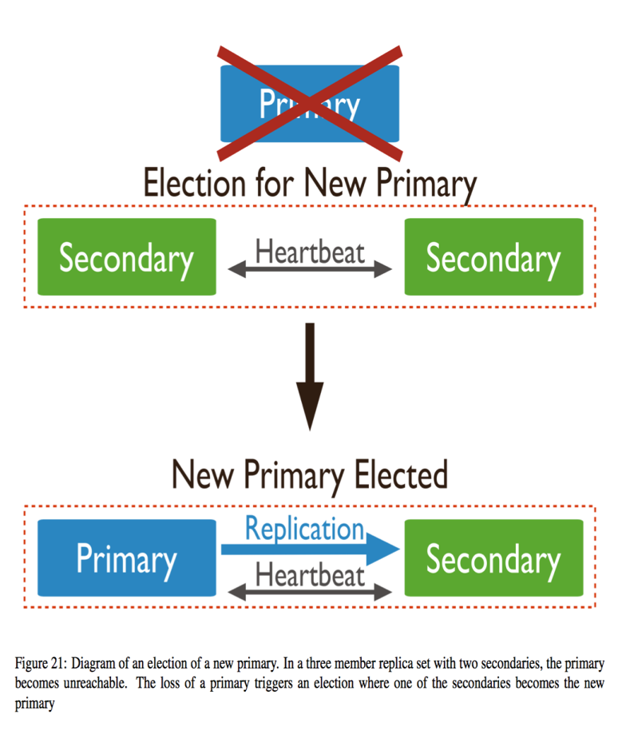
Replication in MongoDB
Automatic Failover
Heartbeats (every 2 seconds)
Elections
The Standard Replica Set Deployment
Deploy an Odd Number of Members
Rollback
Security
SSL/TLS

Slide 92
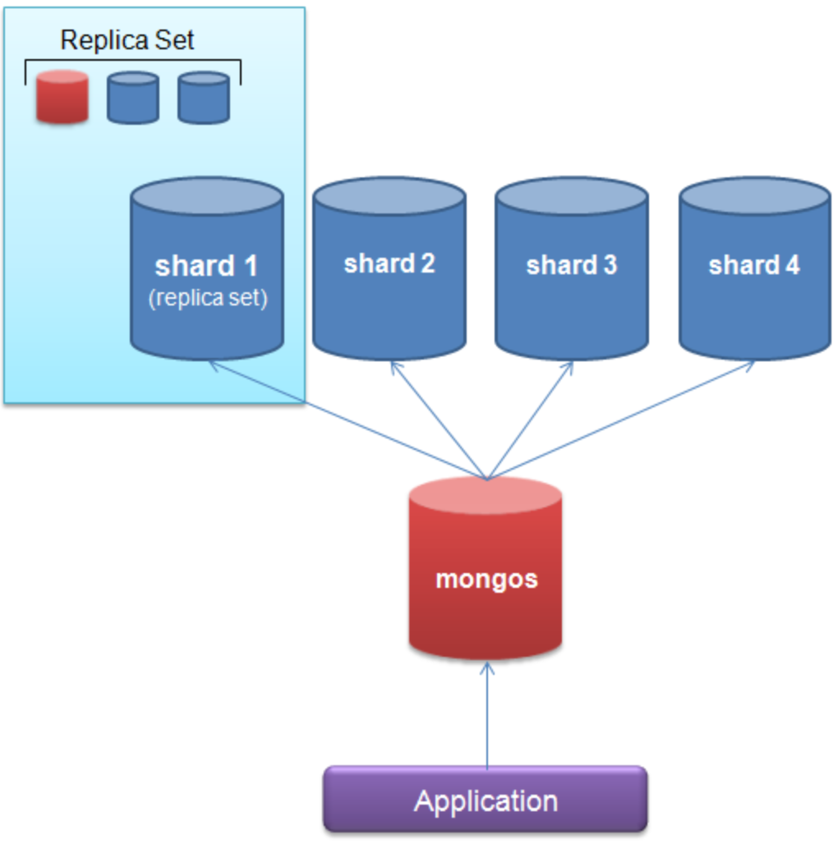
Sharding
What is sharding?
Purpose of sharding
Horizontal scaling out
Query Routers
mongos
Shard keys
Range based sharding
Sufficient cardinality
Enough number of distinct values
Avoid hotspotting
All writes landing on the same shard
Route queries and write operations to shards in a sharded cluster.

Slide 93

CAP Theorem
It is not possible to guarantee all three of the desirable properties at the same time in a distributed system with data replication.
In NOSQL systems, a weaker consistency level is often acceptable, and guaranteeing the other two is important.
All clients always have the same view of the data.
Each client can always read and write.
The system works well despite physical network partitions.

Slide 94
CAP Theorem
No distributed system is safe from network failures, thus network partitioning generally has to be tolerated.
In the presence of a partition, one is then left with two options: consistency or availability.
When choosing consistency over availability, the system will return an error or a time out if particular information cannot be guaranteed to be up to date due to network partitioning.
When choosing availability over consistency, the system will always process the query and try to return the most recent available version of the information, even if it cannot guarantee it is up to date due to network partitioning.
In the absence of network failure -- that is, when the distributed system is running normally -- both availability and consistency can be satisfied.

Slide 95


